Slide 1
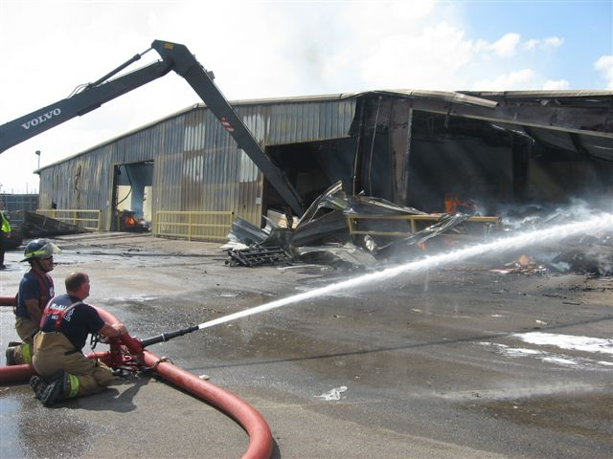
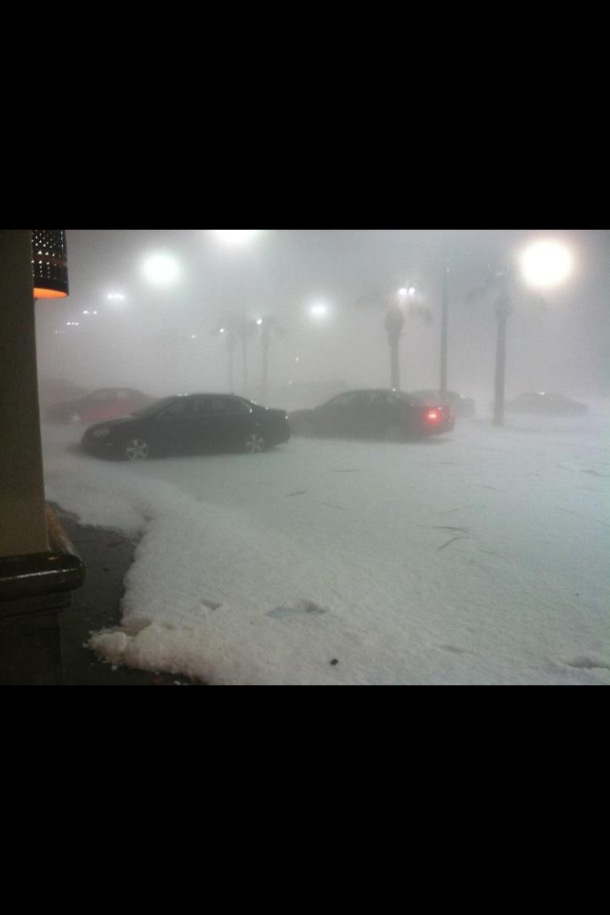
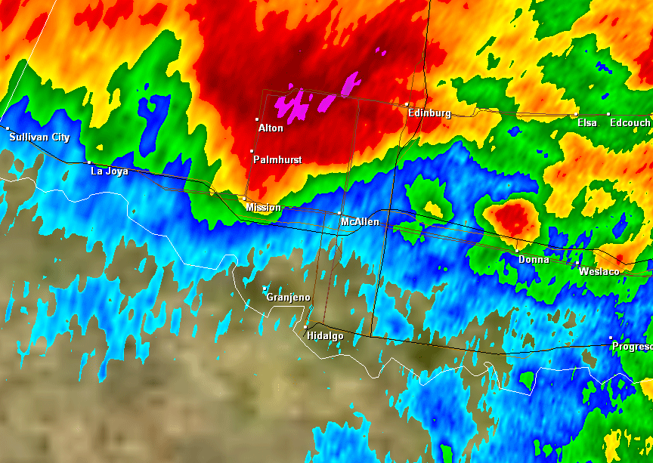
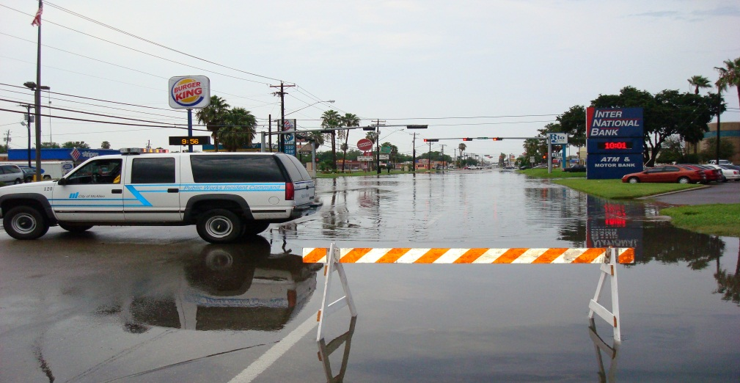
Overview of Emergency Management Law
Kevin D. Pagan, City Attorney / Emergency Management Coordinator

Slide 2
Defining Emergency Management

Slide 3
What is an Emergency?
An emergency is the occurrence or imminent threat of a condition, incident, or event that requires immediate response actions to save lives; prevent injuries; protect property, public health, the environment, and public safety; or to lessen or avert the threat of disaster – (Texas DPS, Texas Division of Emergency Management (Mar. 2013)
See also Tex. Gov’t Code Sec. 433.001, Proclamation of State of Emergency

Slide 4
March 29, 2012 Hail Storm
Very little warning (not a Hurricane!)
1062 residential structure damaged.
63 commercial structures damaged.
26 city facilities damaged -Las Palmas, Main Library and Civic Center major damage.
5,291 homes/business lost power.

Slide 5
SEVERE WEATHER REPORT
March 29, 2012

Slide 6
NWS Radar

Slide 7
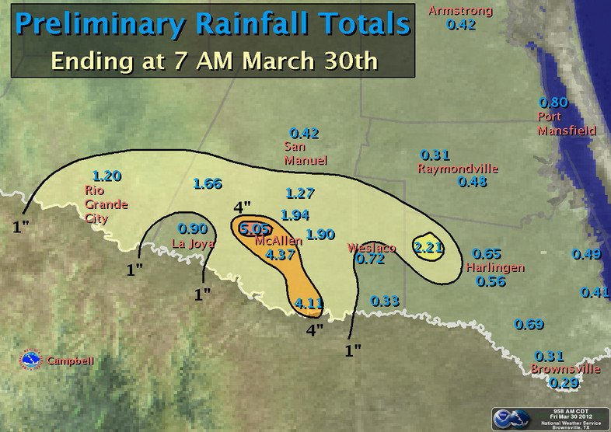

Slide 8
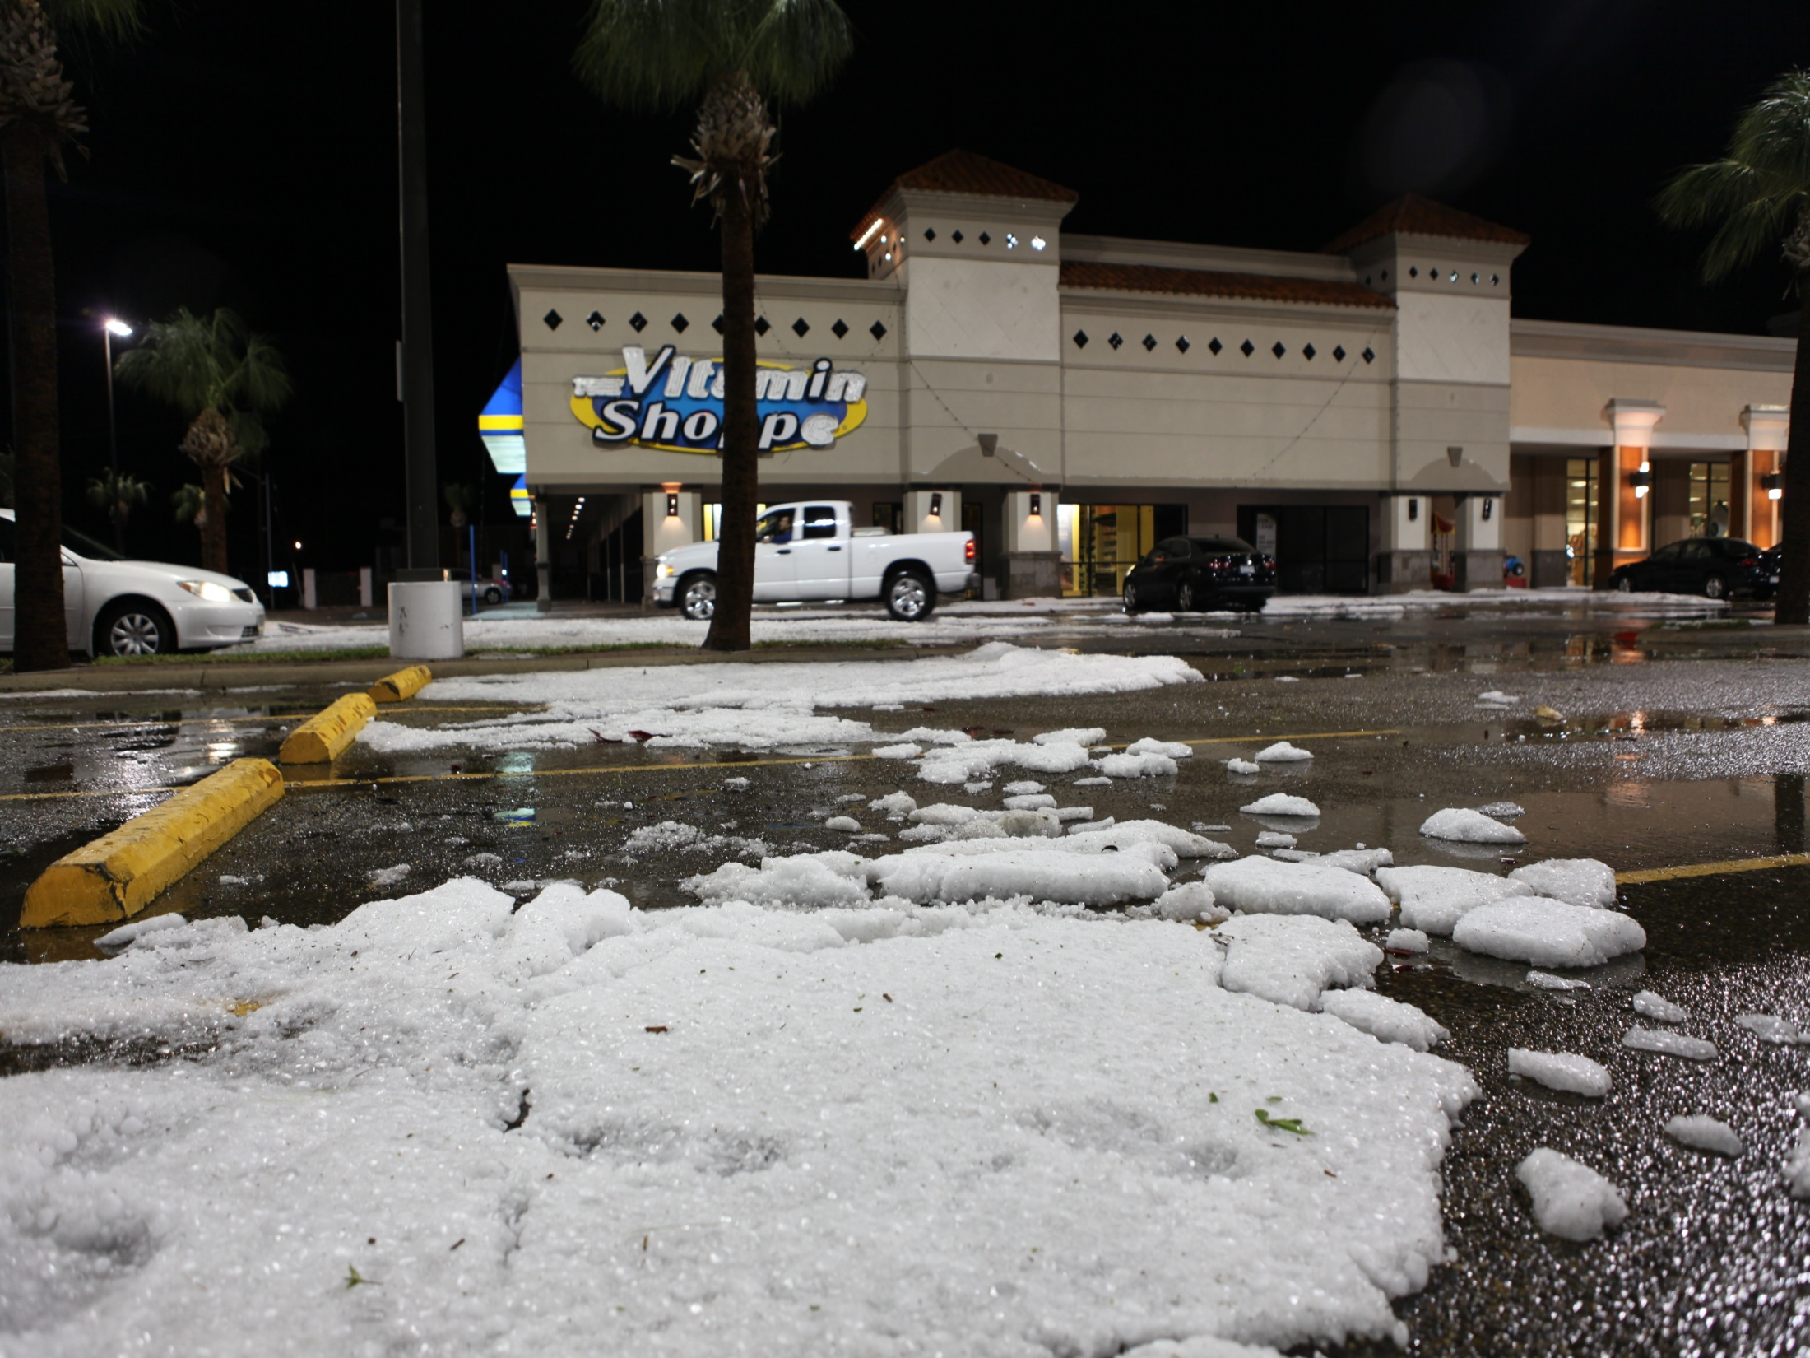

Slide 9
What is Emergency Management?
Is the process of preparing for, mitigating, responding to, and recovering from an emergency.
Includes: Planning, Training, Drills, Testing Equipment and Coordinating Activities.
Is now a recognized “discipline” in education and practice.

Slide 10

“Old” Emergency Management

Slide 11
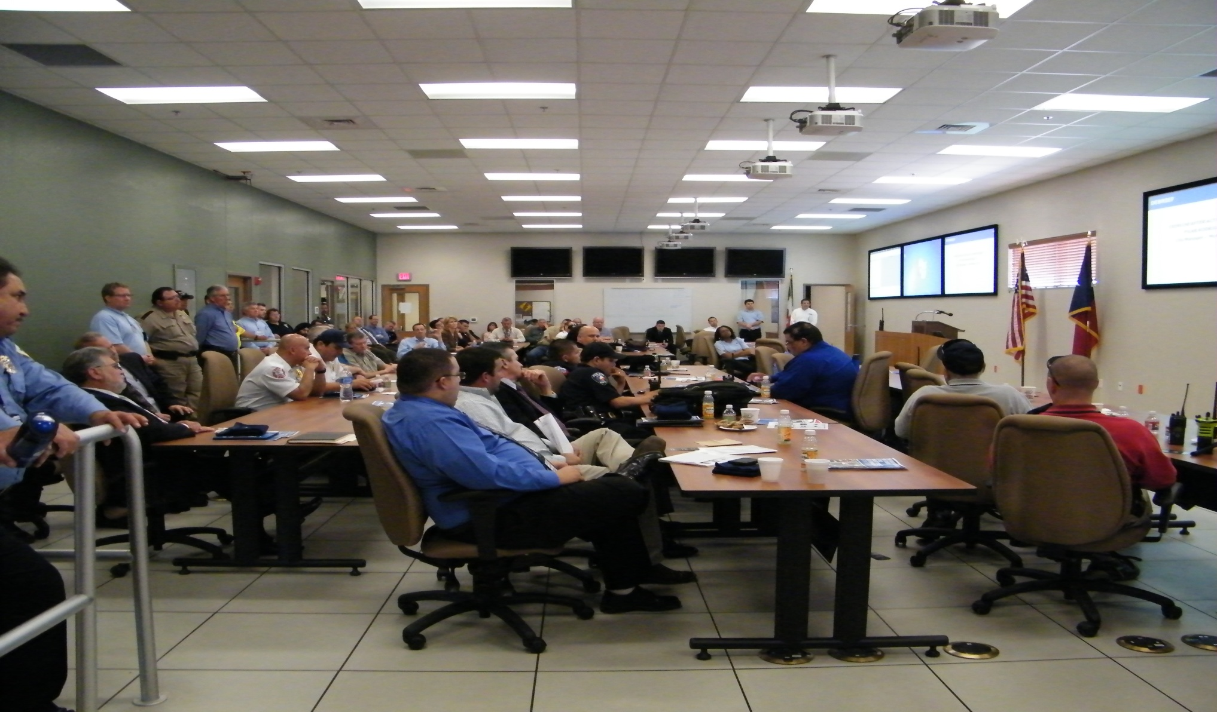
“New” Emergency Management

Slide 12
How and Why has EM changed?
The attacks of Sept 11, 2001
Hurricane Katrina, August 2005
These events exposed weaknesses in systems (interoperability, unified command, etc.)
Created new expectations in public

Slide 13
How and why has EM changed?
Emergency Management is now a recognized academic discipline
New Technology (including Social Media (City of Boston))
Recognition that “events” are “local” but response must be coordinated and unified by and between all levels of government
Example of “reaction”—Hurricane “Dean” and the story of 1,000 buses.

Slide 14
NIMS, ICS, Unified Command and other imponderables

Slide 15
What is NIMS?
The National Incident Management System
NIMS is a comprehensive, national approach to incident management that is applicable at all jurisdictional levels and across functional disciplines.
It is intended to:
  Be applicable across a full spectrum of potential incidents, hazards, and impacts, regardless of size, location or complexity.
  Improve coordination and cooperation between public and private entities in a variety of incident management activities.
  Provide a common standard for overall incident management.

Slide 16
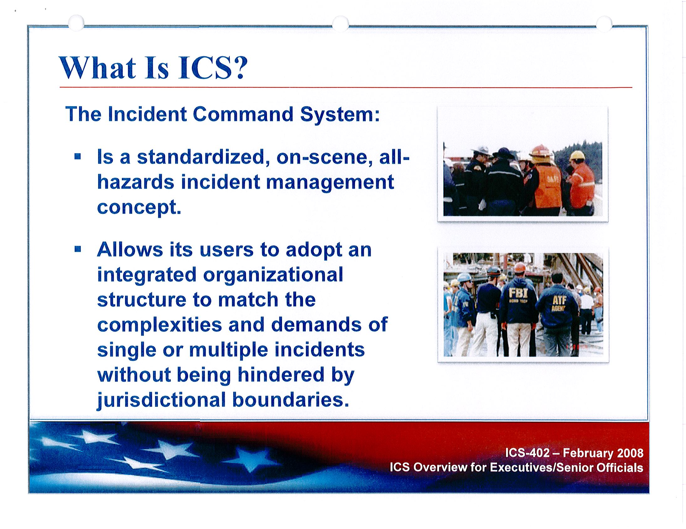

Slide 17
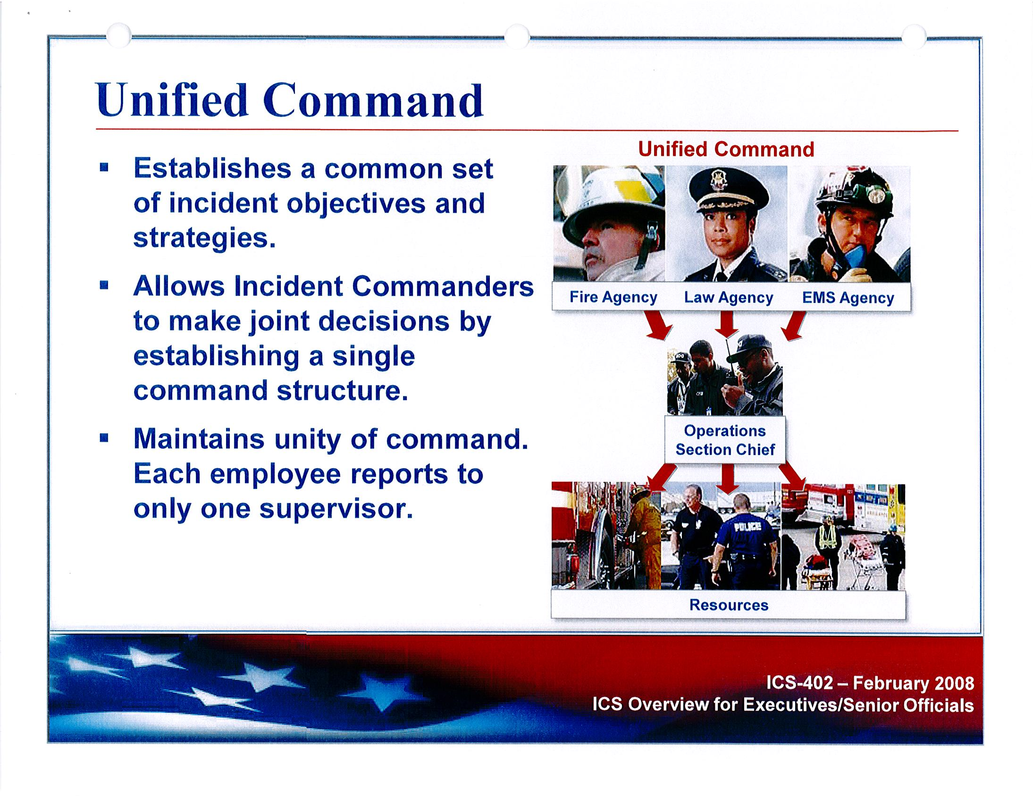

Slide 18
The Key to Everything: Preparation
Develop an Emergency Management Plan
Texas Division of Emergency Management (TDEM) website

Slide 19
Why have an Emergency Plan for your Municipality?
Helps local government fulfill moral responsibility to protect employees, the community and the environment.
Facilitates compliance with regulatory requirements of Federal and State agencies.
Enhances a municipality’s ability to recover from financial losses, regulatory fines, loss of sales tax market share, damages to equipment or facilities or local business interruption.
Reduces exposure to civil or criminal liability in the event of an incident.

Slide 20
Why have an Emergency Plan cont.
Enhances a municipalities image and credibility with employees, regulators, and the community
In some cases, it reduces insurance premiums
An Emergency Plan, training (NIMS) of emergency management personnel AND elected officials is a requirement for Homeland Security Grant Program funding

Slide 21
Emergency Management Plan
ANNEX U - LEGAL
Purpose: “to make provision for legal services during emergency situations or when such situations appear imminent, and to provide guidance for invoking the emergency powers of government when necessary.”

Slide 23
Disaster Preparation
Emergency Notification System (i.e. CodeRed)
MOUs for Cooperation from Regional Partners – Disaster District Chair, Multi-Agency Coordination Center, neighboring jurisdictions, etc.
Be prepared to be self-sufficient for at least 72 hours (FEMA’s average response time)

Slide 24
FEMA Reimbursement
After a Disaster Declaration
Maintain current Standard Operating Procedures, Policies and Processes for:
Emergency purchases
Overtime labor
Emergency contracting
Equipment logs
Etc.
EMERGENCY EXPENSES OVER $62,500 ARE SUBJECT TO A FEMA AUDIT

Slide 25
Duties & Authority
Local Political Subdivisions and State (Governor)

Slide 26
Local Authority:
See Tex. Gov’t Code …
Declaration of Local Disaster (§418.108)
The Mayor or presiding officer is designated as the Emergency Management Director (EMD) for the officer’s political subdivision. The EMD serves as the Governor’s designated agent and may exercise the powers granted to the Governor on an appropriate local scale. See “Governor’s Authority.”
The Mayor may designate an Emergency Management Coordinator (EMC)
to serve as an assistant to the EMD for emergency management purposes.
(§418.1015)
Local government entity may establish inter-jurisdictional agreements to provide mutual aid assistance on request from other local governments
(§418.109 and §418.115, Requesting and Providing Mutual Aid Assistance).

Slide 27
Governor’s Authority:
See Tex. Gov’t Code …
Suspension of Certain Laws/Rules (§ 418.106)
Use of Public and Private Resources (§418.017)
Movement of People (§418.018)
Restricted Sale and Transportation of Materials (§418.019)
Temporary Housing and Emergency Shelter (§418.20)
Clearance of Debris (§418.023)

Slide 28
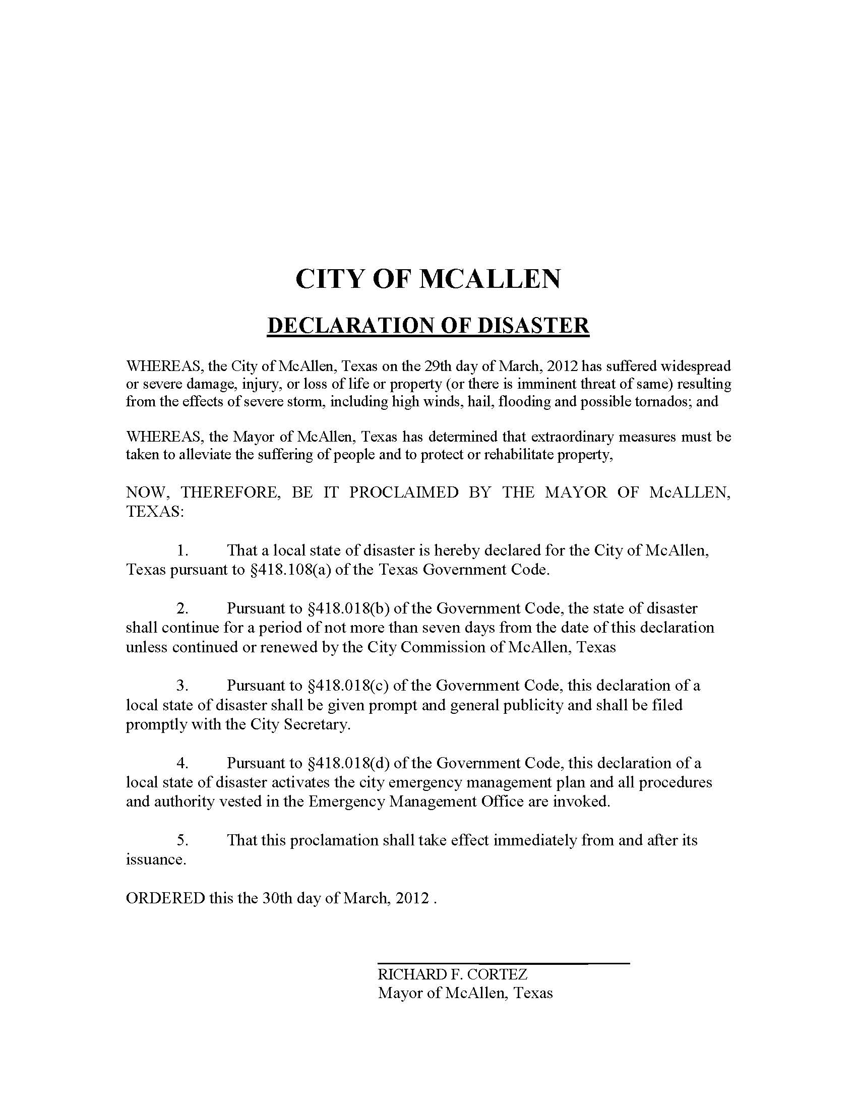

Slide 29
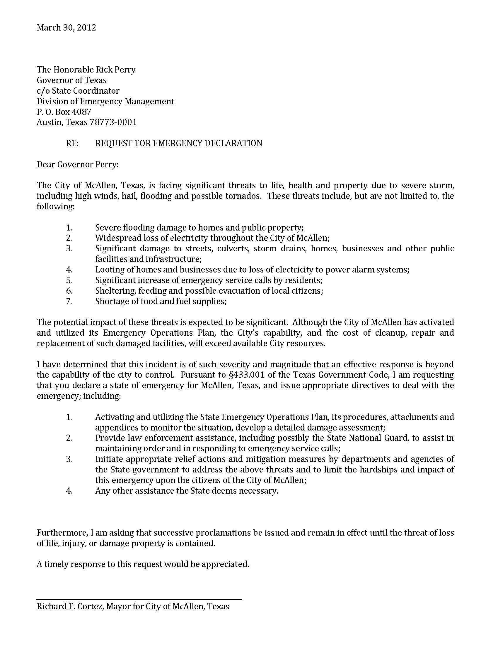

Slide 30
Best Practices
DO’s and DON’Ts

Slide 31
Best Practices
DO’s
Get to know your EM staff before a disaster
Maximize Staff Capabilities
Utilize Social Media to push unified messages
Use Social Media as a data source
Designate personnel in preparation for audit
Get to know your “NGO’s”
Regional Co-Operation
(PUB, IMT, County & State Law Enforcement, etc.)

Slide 32
One Brief Case Study
Regional Cooperation

Slide 33
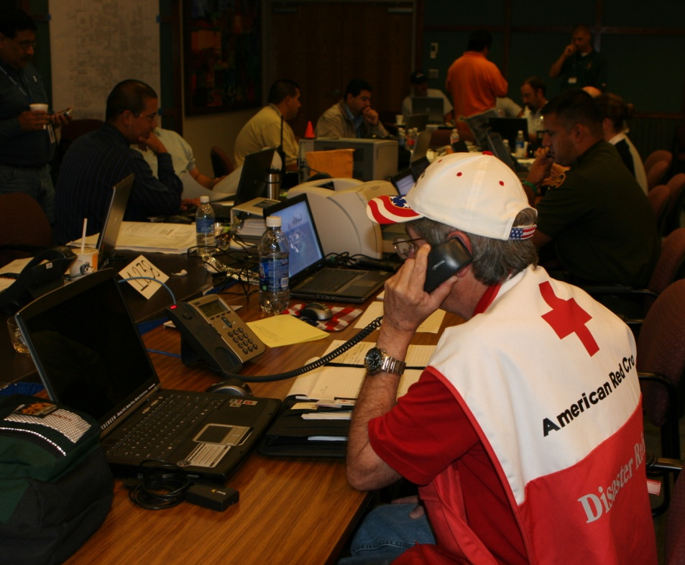
Texas System
(Prior to 2005)
Local EOC >>>>Local County EOC>>>>DDC, etc.
Cooperation locally was “informal” at best
Communication was challenge

Slide 35

Rio Grande Valley system now (3 counties 43 cities, plus other participating agencies (schools, water districts, etc))
Local EOC >>>> Local County EOC >>>> MACC >>>> DDC, etc.

Slide 36
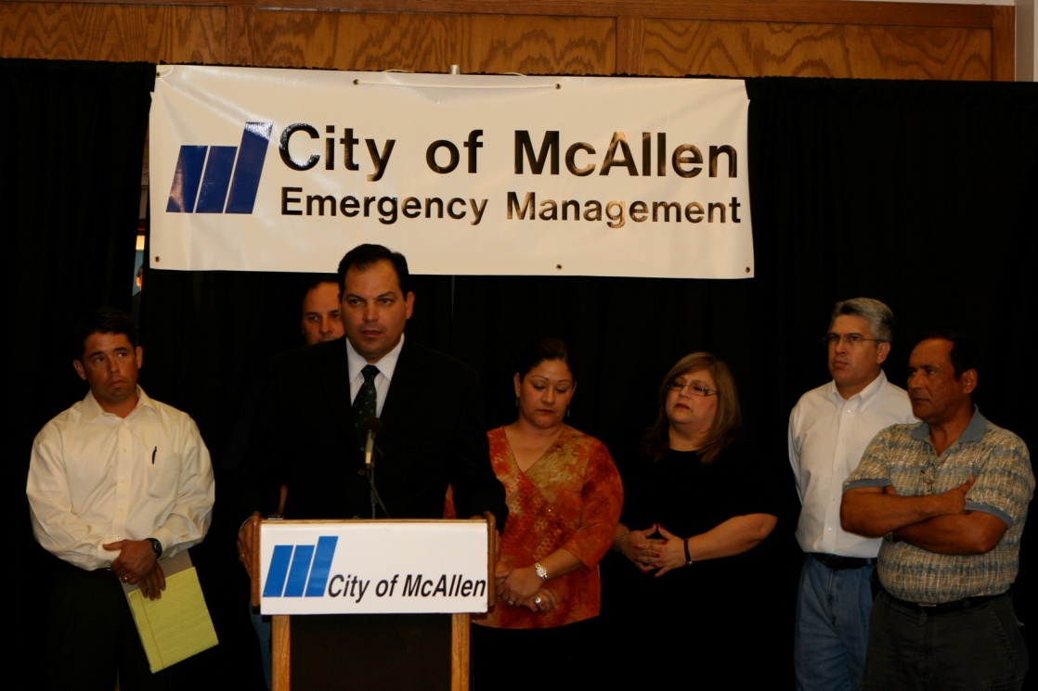
Rio Grande Valley system now (3 counties 43 cities, plus other participating agencies (schools, water districts, etc))
MACC coordinates local resources including:
  City to City (intra and inter county)
  County to County
  Other agencies
MACC interacts with DDC as well as local (county and city) EOC’s

Slide 37
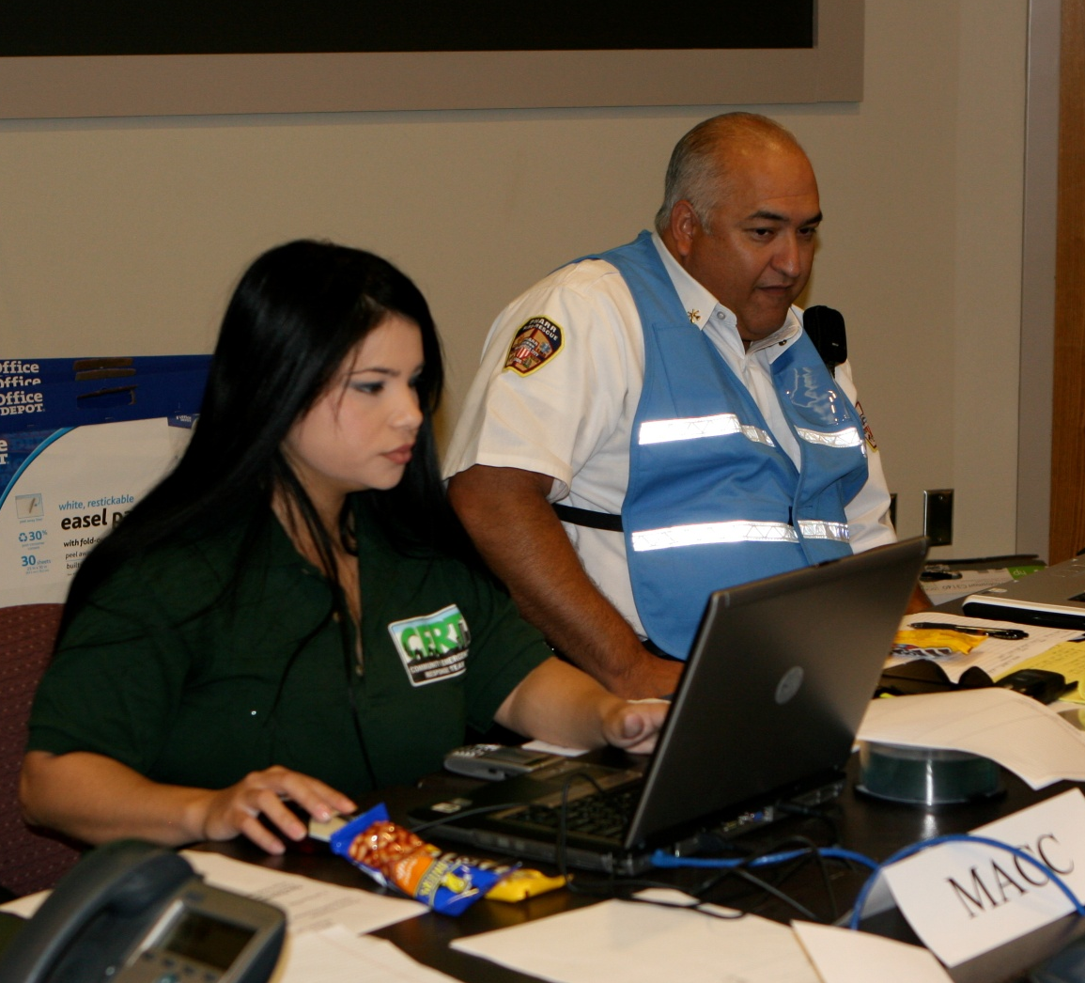
Key Practical Concepts
“Coordination” (NOT command and control)
Communication

Slide 38

Key Practical Concepts
Co-location: e.g. Hurricane Dolly co-location
  City of McAllen EOC
  MACC
  DDC
  Regional Medical Response (“V-MOC”)
  9-1-1 Coordinator (COG)
  Various State/Federal “strike” teams
  FEMA Team
  Various Liaisons

Slide 39
Key Practical Concepts
Local jurisdiction identifies need
Communication with County and/or MACC
MACC / County work together to locate resource
Document:
  With requesting jurisdiction
  With providing / responding jurisdiction

Slide 40
Best Practices
DON’Ts
Presume help for 72 hours after event
Under estimate the recovery period
Become complacent
Forget to incorporate shift changes (we don’t train this very well)
Neglect morale (public employees/ community)
Forget to plan in advance for “HR” issues

Slide 41
FEMA - Emergency Management Guide for Business and Industry
A step by step approach to Emergency Planning, Response and Recovery for Companies of All Sizes.
http://www.fema.gov/pdf/business/guide/bizindst.pdf

Slide 42
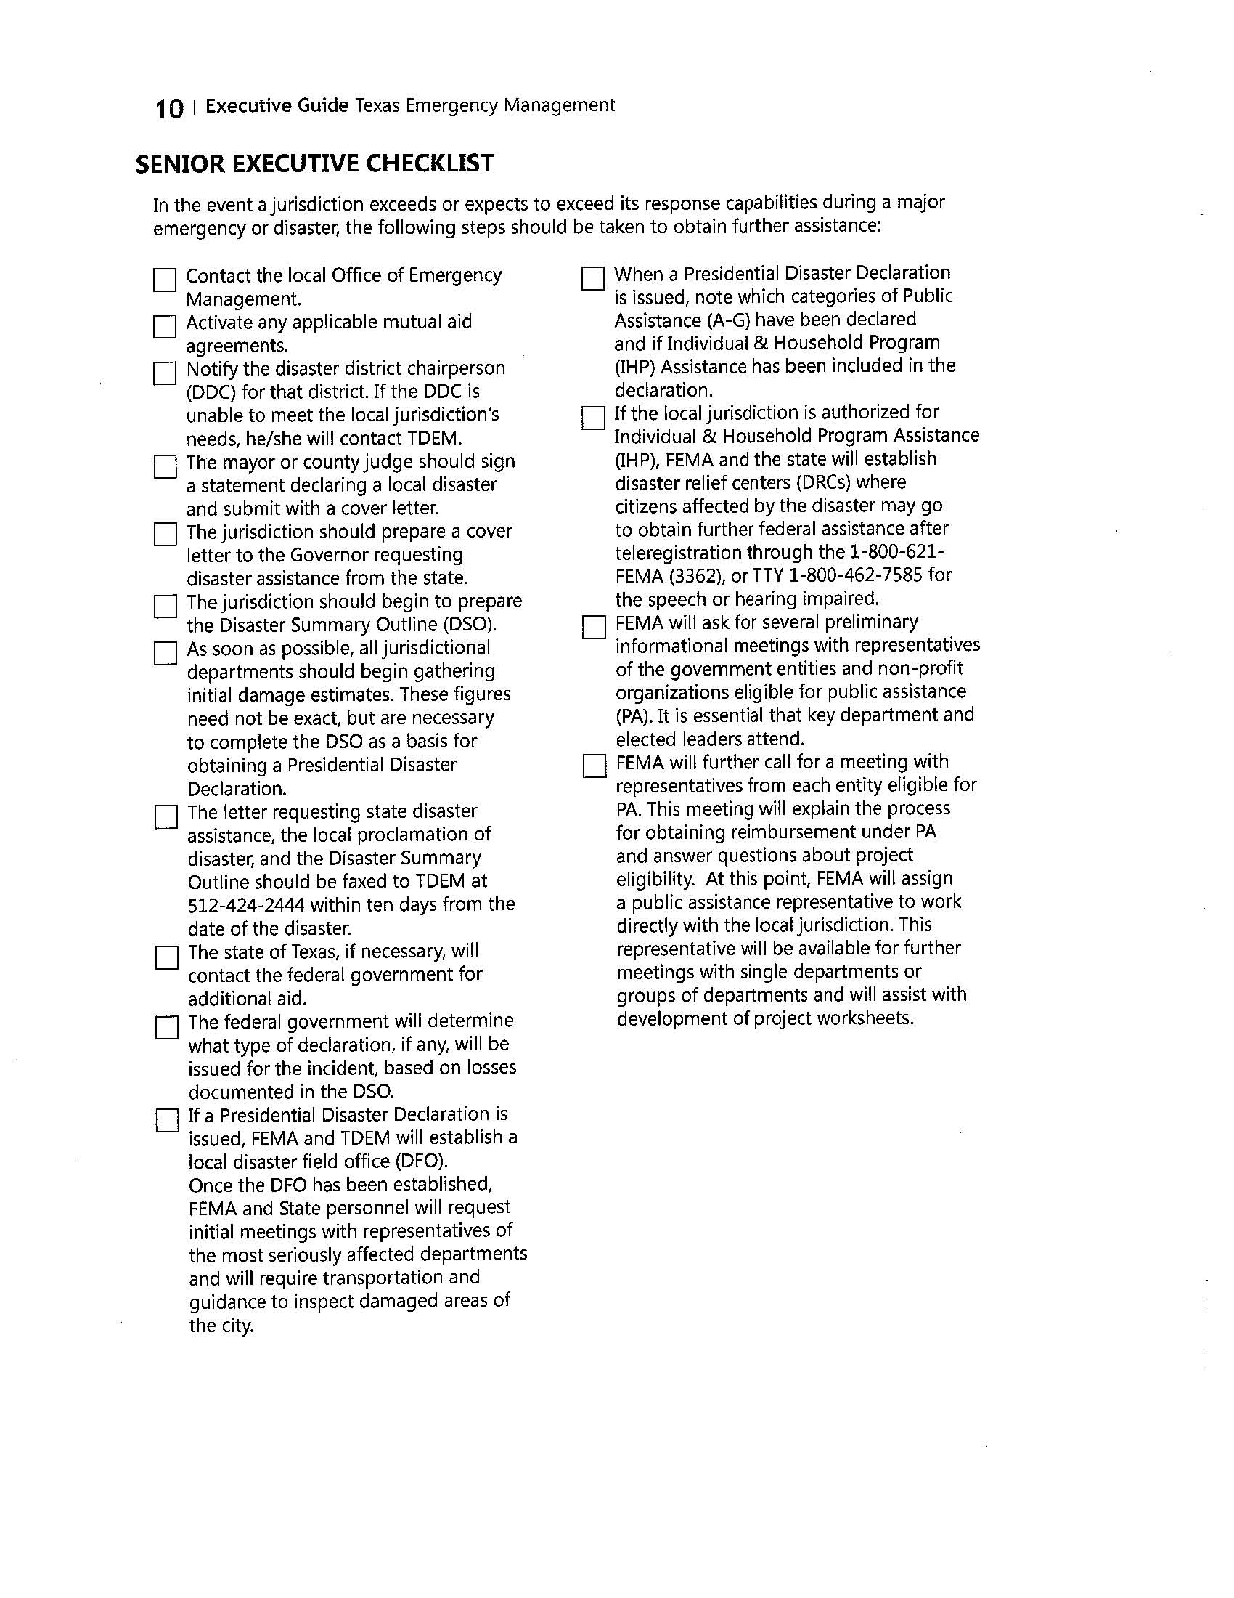

Slide 43
Summary
What should I take away from this Conference?

Slide 44
Take Home Points:
Introduce yourself to the Emergency Management Director/Coordinator.
Familiarize yourself with the Local Emergency Management Plan.
Cultivate relationships with other emergency management officials in the region.
  State/ County/ Local Law Enforcement
  PUB, IMT, and other state/ local agencies
Involve yourself in the emergency preparation process.
Don’t over invest in long term plans and neglect short term planning.

Slide 45
Questions?

