Slide 1
TML Legislative Update: Local Control Takes Some Hits But Mostly Survives
Presenters:
Shanna Igo, TML Deputy Executive Director
Scott Houston, TML General Counsel
Bill Longley, TML Legislative Counsel
Snapper Carr, Focused Advocacy General Counsel

Slide 2
The Numbers
Year | Total Bills Introduced * | Total Bills Passed | City-Related Bills Introduced | City-Related Bills Passed
2001 | 5,712 | 1,621 | 1,200+ | 150+
2003 | 5,754 | 1,403 | 1,200+ | 110+
2005 | 5,369 | 1,397 | 1,200+ | 105+
2007 | 6,374 | 1,495 | 1,200+ | 120+
2009 | 7,609 | 1,468 | 1,500+ | 120+
2011 | 6,303 | 1,410 | 1,500+ | 160+
2013 2015 | 6,061 6,476 | 1,437 1,329 | 1,700+ 1,600+ | 220+ 220+
* Includes bills and proposed Constitutional amendments; regular session only.

Slide 3
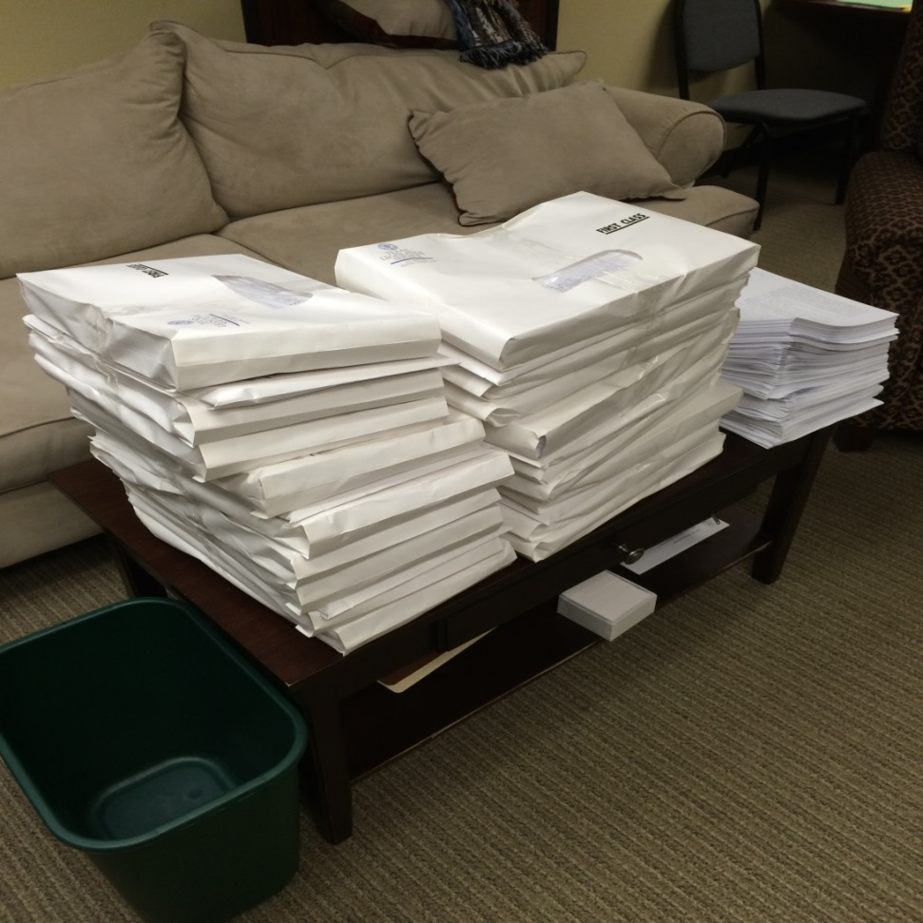
Here’s what that looks like on the bill filing deadline

Slide 4
The “Cutting Room Floor”
The League and city officials defeated legislation that would have:
Reduced the current cap on annual increases in residential appraisals from 10 percent to some lesser amount, applied the cap to all real property; or capped city revenues.
Limited the ability of cities to issue debt.
Eliminated municipal annexation authority.
[House Floor Annexation Debate Video]

Slide 5
The “Cutting Room Floor”
The League and city officials also defeated legislation that would have:
Eliminated the ability of city officials to lobby or to join an association that lobbies on their behalf.
Required a city to pay money damages for a violation of the permit vesting law.
Required expensive cost-benefit analysis and reporting prior to the adoption or amendment of building codes.
Make criminals out of police officers who enforce federal law.

Slide 6
The “Cutting Room Floor”
We defeated PREEMPTION legislation that would have:
Eliminated the concept of “home rule” cities.
Preempted ANY city regulation not expressly authorized by state law, or specifically preempted ordinances on plastic bags, payday/auto title lenders, Uber/Lyft, red light cameras, texting while driving, and more.

Slide 7
Property Tax
HB 1953 (D. Bonnen/Hinojosa): Property tax rate notice deadline
SB 1/SJR 1 (Nelson/D. Bonnen): $25k school district homestead exemption
SB 1760 (Creighton/D. Bonnen): 60 % vote, notice, refunds, property tax rate notice deadline

Slide 8
Purchasing
HB 1295 (Capriglione/Kolkhorst): Vendor disclosure – SEEKING VETO
HB 2049 (Darby/Eltife): Duty to defend in architects/engineers contracts

Slide 9
Open Government
HB 283 (Fallon/Creighton): Recording and broadcasting of meetings in cities over 50,000
HB 685 (Sheets/Hancock): PIA and website information
HB 2134 (Burkett/Hall): Email clarification
HB 2152 (Fletcher/Estes): Military service information
HB 2163 (Hernandez/Perry): Auto accident information

Slide 10
Other Finance/Administration
HB 1 (Otto/Nelson): State Budget
HB 23 (S. Davis/Huffman): Conflicts disclosure
HB 1378 (Flynn/Bettencourt): Local debt reporting

Slide 11
Municipal Courts
HB 1436 (Smithee/Lucio): Dangerous dog appeals
H.B. 1386 (Raymond/Ellis): Number of attorneys for defense or prosecution

Slide 12
Community/Economic Development
HB 1736 (Villalba/Fraser): Energy efficiency standards
HB 1949 (Springer/V. Taylor): Annexation of roads or general law annexation of noncontiguous area
H.B. 2735 (Capriglione/Hancock): Wet/dry status after annexation
SB 1812 (Kolkhorst/Geren): Eminent domain reporting

Slide 13
Personnel
H.B. 593 (Collier/Whitmire): Police animal encounter training
H.B. 786 (Walle/Zaffirini): Breastfeeding
H.B. 1151 (S. Thompson/Garcia): Harassment of unpaid interns
HB 2828 (Phillips/Burton): Criminal background check for applicants, employees, vendors, volunteers

Slide 14
Public Safety
HB 324 (Dutton/Burton): Body cavity searches
HB 910 (Phillips/Estes): Handgun open carry
HB 1036 (E. Johnson/Whitmire): Police officer-involved injury or death reporting
SB 158 (West/Fletcher): Body cameras
SB 273 (Campbell/Guillen): Concealed handgun signs
SB 1593 (Lucio/Lucio): Sale of fireworks

Slide 15
Utilities and Environment
HB 40 (Darby/Fraser): Oil and gas operations
[Oil and Gas House Floor Debate Video]

Slide 16
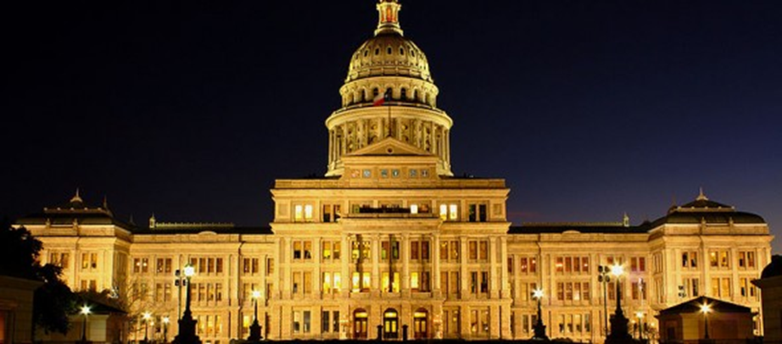
QUESTIONS?
www.tml.org

